Slide 1

Ramco Institute of Technology

Slide 2
Ramco Institute of Technology
Ramco Institute of Technology is founded with a vision to impart high quality engineering education at an affordable cost. Under the able guidance of our Chairman Shri P. R. Ramasubrahmaneya Rajha, son of Shri P A C Ramaswamy Raja; distinguished professionals, academicians and education experts, we continually aim to revolutionize the learning environment by creating an enviable knowledge pool of engineering and technology graduates who are attuned to the current industry requirements.

Slide 3
Vision:
To evolve as an Institute of international repute in offering high-quality technical education, Research and extension programmes in order to create knowledgeable, professionally competent and skilled Engineers and Technologists capable of working in multi-disciplinary environment to cater to the societal needs
Mission:
To accomplish its unique vision, the Institute has a far-reaching mission that aims:
To offer higher education in Engineering and Technology with highest level of quality, Professionalism and ethical standards
To equip the students with up-to-date knowledge in cutting-edge technologies, wisdom, creativity and passion for innovation, and life-long learning skills

Slide 4
Activities:
Organizing Workshops, conferences and symposia with joint participation of the faculty and the industries
Memoranda of Understanding between the Institute and industries to bring the two sides mutually closer.
U.G Projects/dissertation work in industries under joint guidance of the faculty and experts from industry.
Arranging visits, Industrial Training & Internship for Students and faculty members to various Industries.
Visits of industry executives and practicing engineers to the Institute for seeing research work and laboratories, discussions and delivering lectures on industrial practices, trends and experiences
Collaborating for Curriculum design and development, Research and Development, Consultancy activities
Sharing and utilization of resources/infra structural facilities for training, research and other promotional activities
Providing solutions for the industrial problems

Slide 5
Courses Available:
Civil Engineering
Computer Science & Engg.
Electrical & Electronics Engg.
Electronics & Communication Engg.
Mechanical Engineering
B.Tech Artificial Intelligence and Data Science
B.Tech. Computer Science and Business Systems
B.Tech. Information Technology

Slide 6
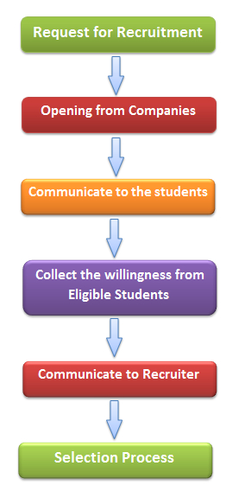
Placement Training Programs :
Personality Development Program
Communication Skills Program
Resume Preparation
Group Discussion Practice
Mock Interview Sessions
Aptitude Training
Programming Training
Company Specific Training

Slide 7
THANK YOU

